Slide 1


Forest Fire Detection Using Deep Learning
Name: Ananya Chesta
AICTE Internship Student Registration ID:
STU67dc1125b4c691742475557
AICTE Internship ID:
INTERNSHIP_174099535967c57b1f336c3

Slide 2

Learning Objectives
Understanding the Use of CNN in Forest Fire Detection :
Convolutional Neural Networks (CNNs) are a type of deep learning model primarily used for analyzing visual imagery.
In forest fire detection, CNNs can automatically classify images captured from surveillance cameras, drones, or satellites into two categories: fire and no fire.
They eliminate manual feature extraction by learning important visual patterns directly from raw image data
Advantages of CNN in Forest Fire Detection:
CNNs detect fire and smoke automatically with high accuracy, reducing missed fires.
They process images quickly, enabling real-time detection and faster emergency response
GOAL
Source :
www.freepik.com/

Slide 3
Learning Objectives
Understanding Conv2D Layer:
Conv2D is a key layer in CNNs used to extract features from images.
Applies filters (kernels) to input images. Each filter detects specific patterns (e.g., edges, textures).
Enables automatic understanding of fire characteristics in images.
Generates feature maps that highlight important regions.
GOAL
Source :
www.freepik.com/

Slide 4
Preprocess images by resizing (e.g., 128x128) and normalizing pixel values (scale 0-1).
Learning Objectives
Exploring and Building the CNN Model for Forest Fire Detection:
Begin by understanding the dataset: labeled images of forests with fire and without fire.
Preprocess images by resizing and normalizing pixel values for consistent input.
Build the CNN architecture using layers:
Conv2D layers to extract features like edges and flames.
Dense layers for classification into fire or no-fire classes.
Train model on training data, validate with separate set, and adjust for accuracy.
GOAL
Source :
www.freepik.com/

Slide 5
Tools and Technology used
Development Environment
Google Colab :– For writing and running code interactively.
Python :– Core programming language used throughout the project.
Model and Hardware Used
Models used:- CNN
Hardware used:- Graphics Processing Unit (GPU) (Example: NVIDIA Tesla T4 / RTX 3060)
Deep Learning Frameworks
Frameworks | Used
TensorFlow | For building and training the CNN model.
Keras | High-level API to quickly create CNN layers and architectures.

Slide 6
Methodology
The steps involved in the methodology for forest fire detection using CNN are as follows :
Step 1: Data Collection Gather a labeled image dataset with two categories: Fire and No Fire.
Step 2: Data Preprocessing Resize all images (e.g., to 128×128), normalize pixel values (0–1), and apply augmentation for better generalization.
Step 3: Model Building Design a CNN model using Conv2D, MaxPooling, Flatten, and Dense layers with a sigmoid output.
Step 4: Model Compilation Use binary cross-entropy loss and Adam optimizer to prepare the model for training.
Step 5: Training and Validation Train on the training set and validate on a separate set to avoid overfitting.
Step 6: Evaluation Test model performance using accuracy, loss, and confusion matrix.

Slide 7
Problem Statement:
Forest fires are unpredictable and spread rapidly, causing severe damage to the environment, wildlife, and human life. Traditional fire detection methods are slow, manual, and often inefficient. There is a critical need for an automated, accurate, and real-time detection system. This project aims to develop a Convolutional Neural Network (CNN)-based model that can classify images into fire and no-fire categories to enable early detection and faster response.
Objectives
To develop a CNN-based model for binary classification of fire and no-fire images.
To automate forest fire detection using real-time image inputs.
To reduce detection time and improve response accuracy.
To build a model that can be deployed on drones, CCTV, or surveillance systems.
ObjectiveA critical problem is theccurate classification of visual data (images or frames) into two categories: fire (images containing visible fire, smoke, or flames) and non-fire (images with normal vegetation, clouds, or similar non-hazardous scenes). Due to similarities in visual features like fog, sunlight glare, or orange light reflections, traditional methods struggle to distinguish between the two accurately.
Therefore, this project aims to solve the problem by building a CNN-based model that can learn and identify visual differences between fire and non-fire images, enabling fast, reliable, and automated forest fire detection in real-time conditions.
s

Slide 8
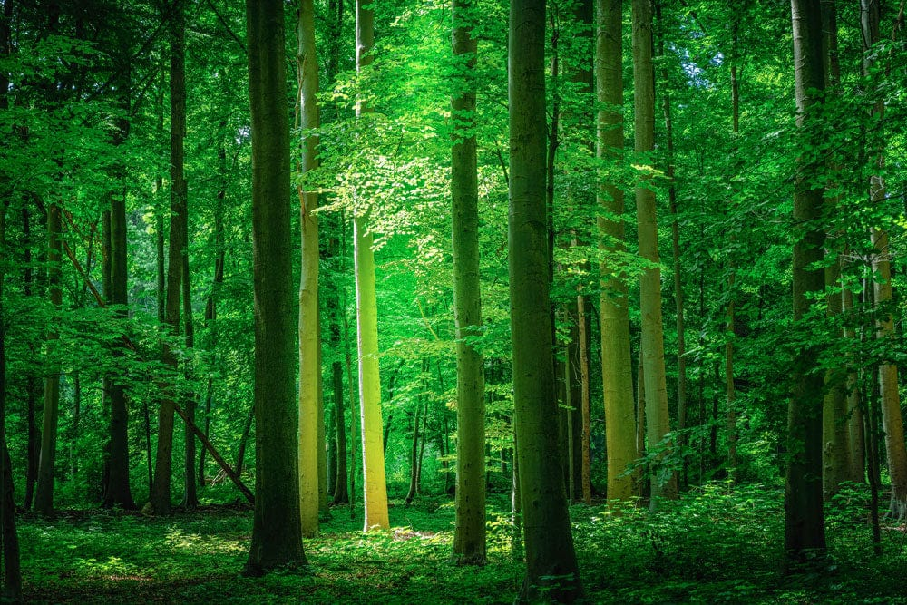
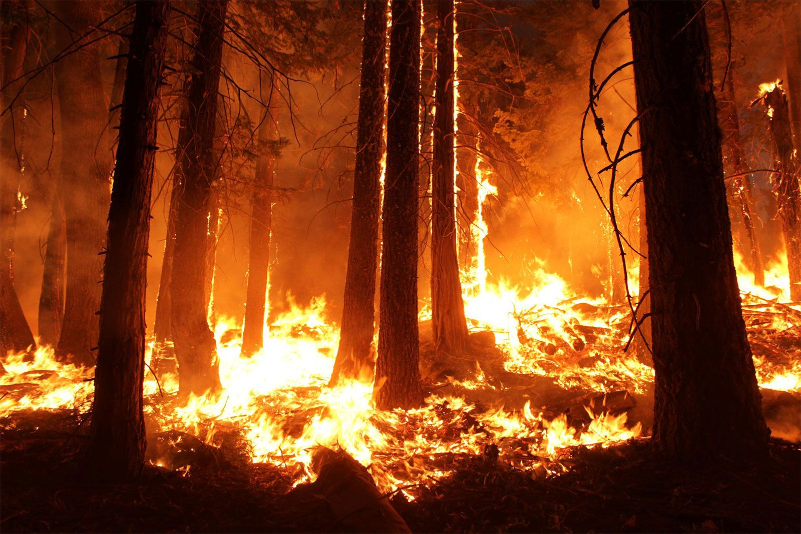
Problem Statement:
A critical problem is the accurate classification of visual data (images or frames) into two categories: fire (images containing visible fire, smoke, or flames) and non-fire (images with normal vegetation, clouds, or similar non-hazardous scenes). Due to similarities in visual features like fog, sunlight glare, or orange light reflections, traditional methods struggle to distinguish between the two accurately.
Therefore, this project aims to solve the problem by building a CNN-based model that can learn and identify visual differences between fire and non-fire images, enabling fast, reliable, and automated forest fire detection in real-time conditions.
No Forest Fire
Forest Fire

Slide 9
Scalable – Can be deployed across large forest areas using drones or IoT.
Solution:
The project uses a Convolutional Neural Network (CNN) to automatically classify images as fire or no fire. The model is trained on labeled images and learns to detect fire-related features like smoke and flames. Once deployed, it can analyze real-time footage from cameras or drones and instantly alert authorities when a fire is detected, enabling quick response and reducing damage. Here is the github link for the code https://github.com/AnanyaChesta25/Week3.git
Example Use Case:
A drone patrols a forest reserve and captures live images. The images are fed into the CNN model, which instantly detects signs of fire (like smoke or flames) and triggers an alert to forest officials for immediate action.
Advantages:
Real-Time Detection – Identifies fire instantly from camera feeds.
High Accuracy – Learns visual fire patterns, reducing false alarms.
Automation – No need for manual observation or feature selection.
Adaptable – Improves over time with more data and different environments.

Slide 10
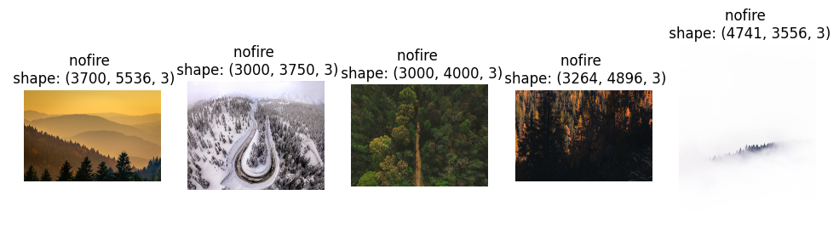
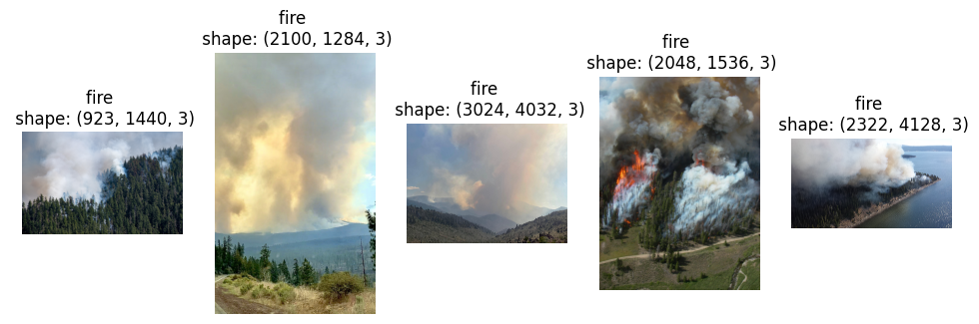
Screenshot of Output:
No Fire Images
Fire Images

Slide 11
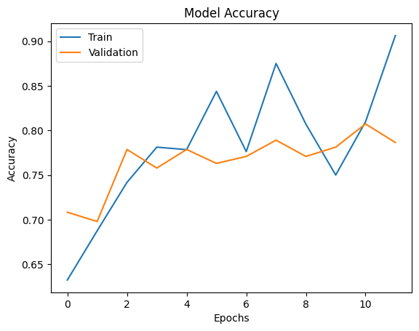
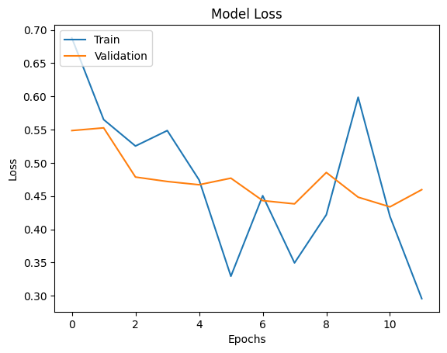
Screenshot of Output:

Slide 12
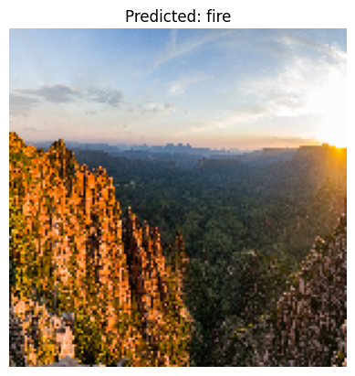
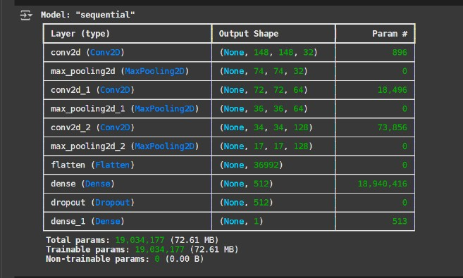
Screenshot of Output:

Slide 13
Conclusion:
The project successfully developed a CNN-based model capable of classifying fire and non-fire images with high accuracy. By automating the detection process, the system helps monitor forests in real time, allowing quicker responses and reducing the risk of large-scale damage. The model is adaptable, scalable, and suitable for integration with modern surveillance tools like drones and cameras.
CNN model accurately detects fire from visual data.
Enables real-time, automated forest monitoring.
Reduces manual effort and speeds up emergency response.
Scalable for large forest areas using drone or satellite feeds.
Helps protect the environment and save resources.

